Slide 1
Atom Client Gui Design
Ideas

Slide 2
Sqllite as local database

Slide 3
Design as Plug-in Framework
Make the Atom Client as a management tool
Extendable capability by configuration
Configuration decide the :
Layout (menus, available tools)
Module (only load needed python code)
Workflow (define what is the next step)
Connection info
To test machine, to staging machine, to prod machine…
Configuration info storage
Option 1 local encrypted xml
Option 2 backend database
Option 3 sqlite as local database

Slide 4
Three tiers design
User Interface tier
Collect user input information
Do simple input check (data type, data length, user authentication access…)
Generate View Module
Business logic tier
Do data business logic check on View Module
Do data prepare for transfer tier
Define every rule and convert as single class (avoid mixed code)
Use common interface to visit every rule and convert
Generate Transfer Module
Data transfer tier
Get the data (can be xml) form the Transfer Module
Submit the request to the Lower layer

Slide 5
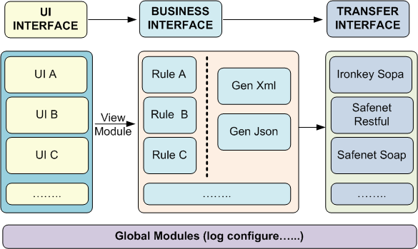
Outside of the three tiers
Global log module
Global configure module

Slide 6
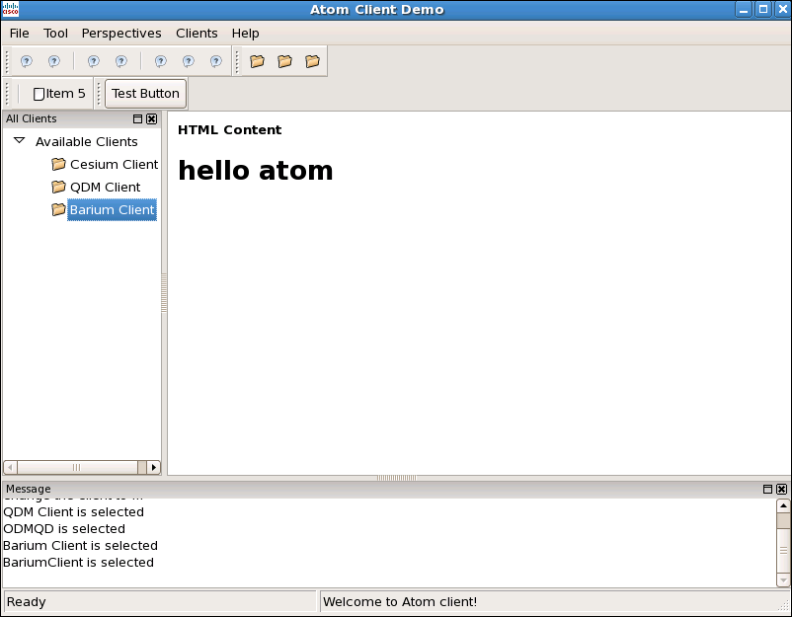
Rough Layout design
Menu Bar
Avalibale Tools
Tool Main Frame
Output Message

